Slide 1
Buffalo River Data Collection
Riley Blasiak
03/12/2024

Slide 2
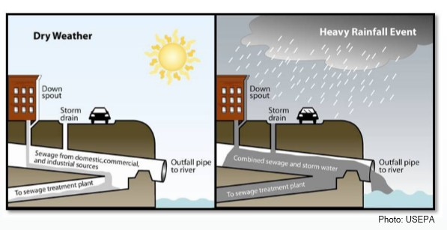

Slide 3
Problem Statement
End Goal: Characterize combined sewer discharge water quality at outfalls
Intermediate Goal: Determine River water quality at each node
Train a supervised learning model to predict river water quality based on precipitation
Classify river water quality as poor or good using GNN-> might indicate there was a discharge
Somehow use parameters of river water quality to back calculate discharge water quality—maybe use a subset network

Slide 4
If I predict water quality using precipitation, can I use precipitation in the GNN

Slide 5
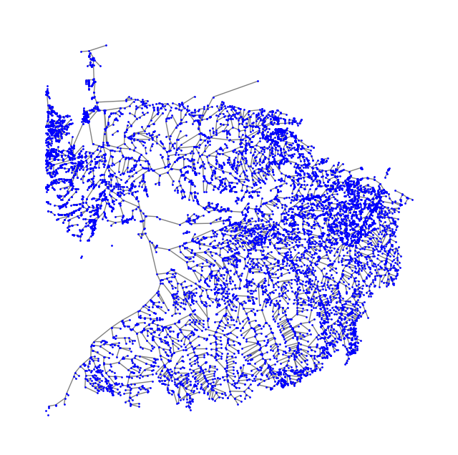
Buffalo’s River Network
Currently undirected, should be directed
Nodes: 9880
Edges: 10027
The graph is not connected, the diameter is not defined
Node with the highest degree is located at -78.98, 42.99 with degree 4
Notes:
Plot rivers with thickness, plot river flow as color

Slide 6
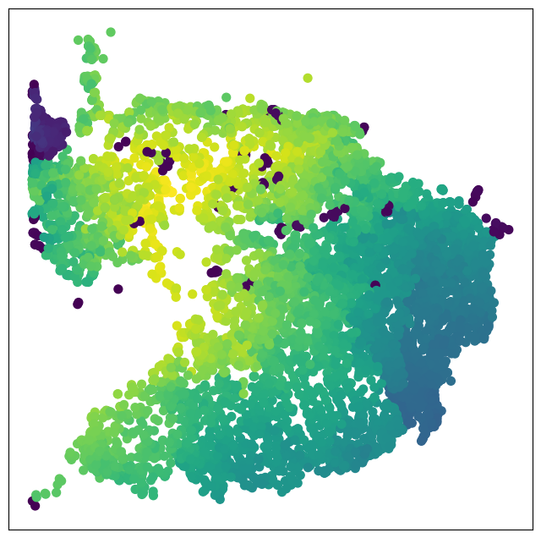
Closeness centrality
Yellow closest to all node
Purple furthest from all

Slide 7
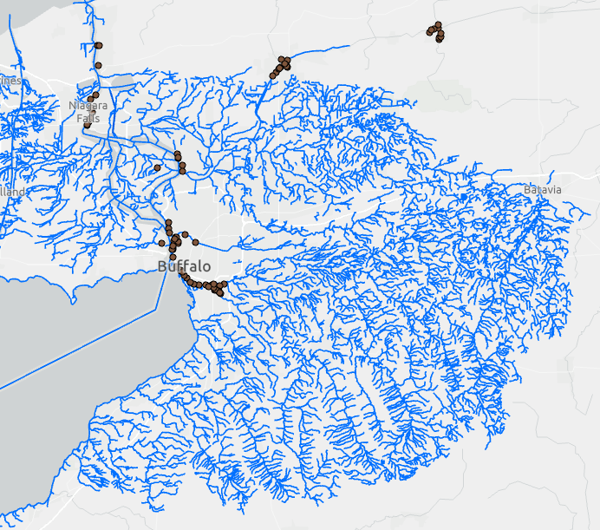

Slide 8
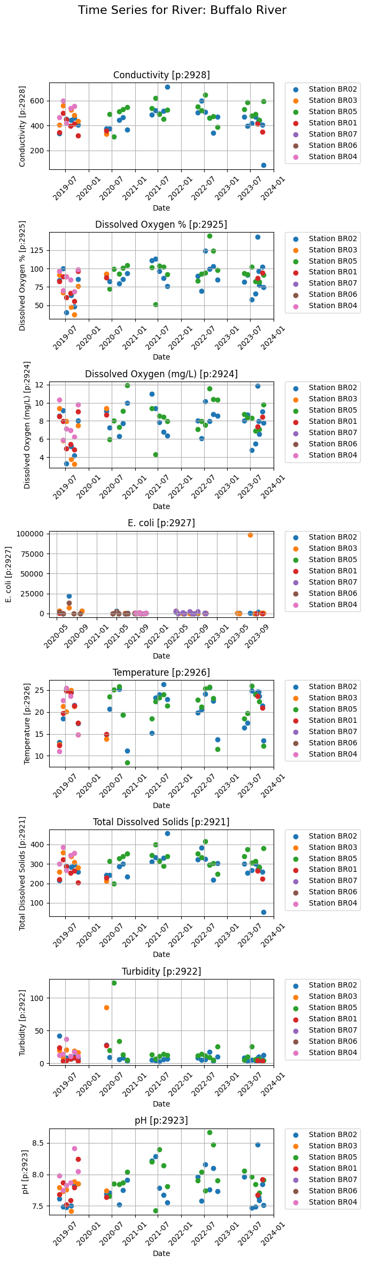
Buffalo Niagara Water Keeper Data

Slide 9
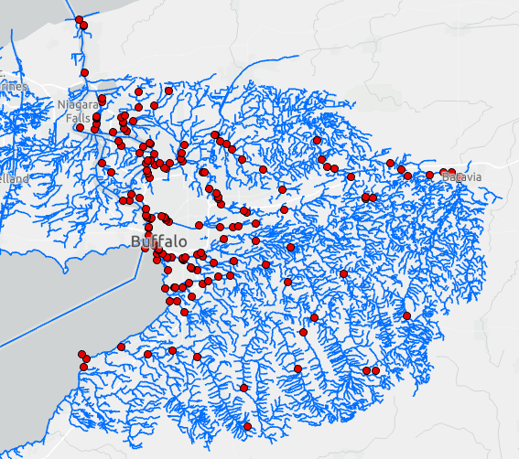

Slide 10
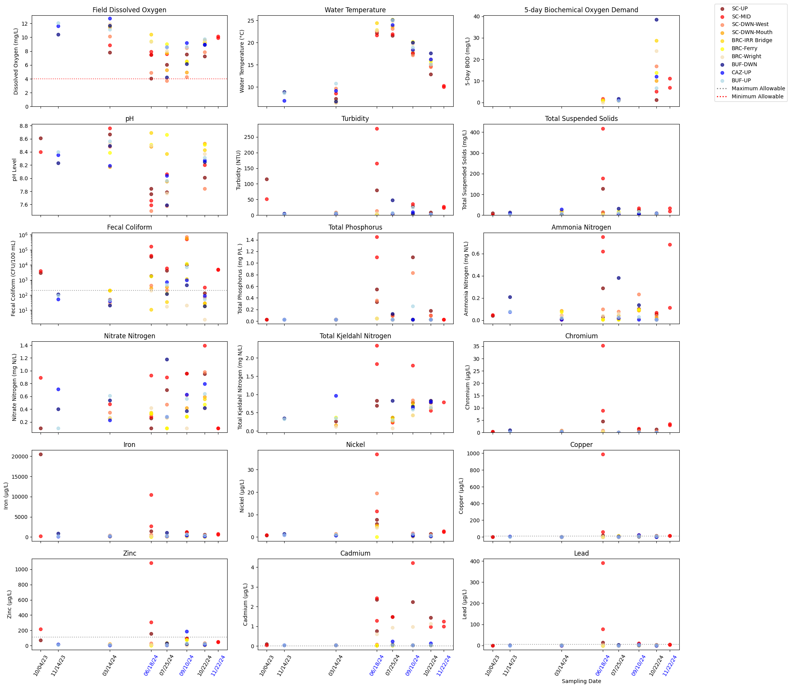
UB River Water Quality Samples

Slide 11
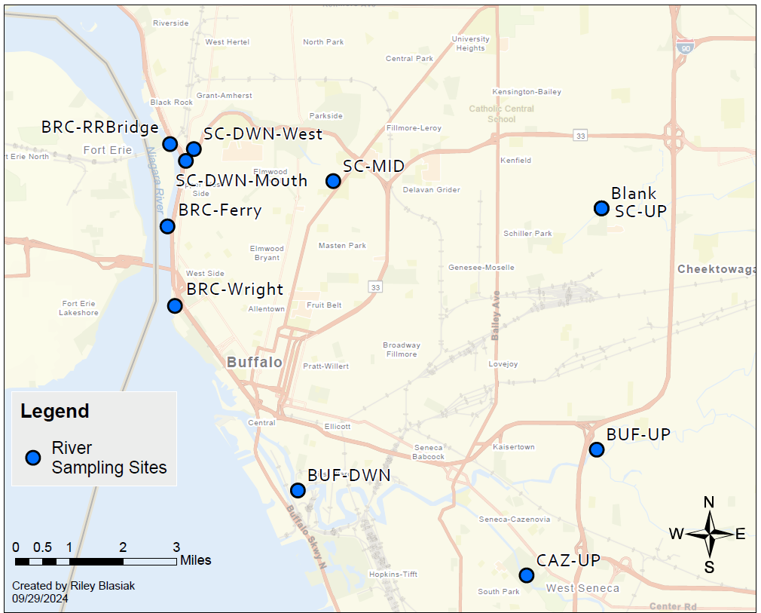
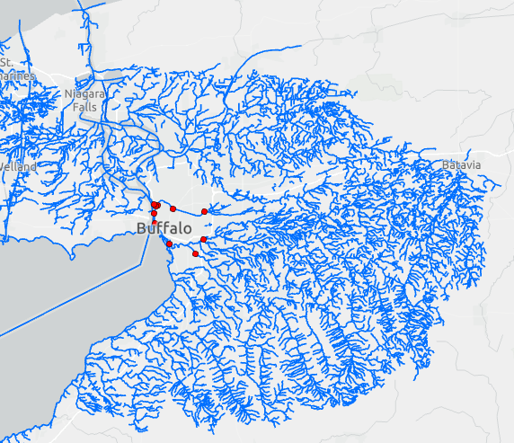

Slide 12
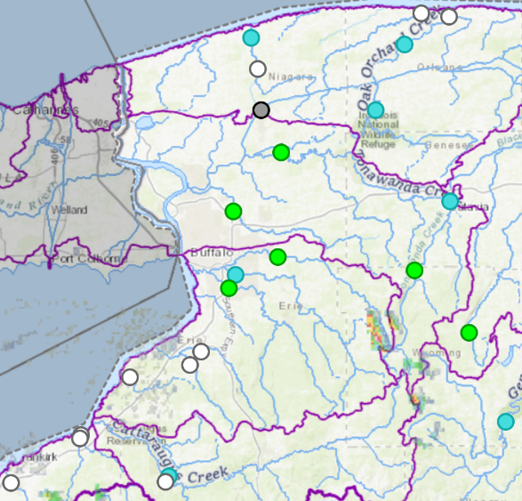
Flow data
7 sites from 1990-10-01 to today
3 sites from 2017-09-22 to today
From: https://dashboard.waterdata.usgs.gov/app/nwd/en/

Slide 13
Precipitation data
Is the airport data sufficient?
Should I use Radar data?

